Slide 1
Relational-Database Design
schema normalization
— Chapter 7
2021年11月
叶文
yewen@bupt.edu.cn
School of Computer Science (National Pilot Software Engineering School)

Slide 2
Outline
Features of Good Relational Design
Decomposition Using Functional Dependencies
Normal Form
Functional Dependency Theory
Algorithms for Functional Dependencies
(Decomposition Using Multivalued Dependencies)
(More Normal Form)
(Database-Design Process)
(Modeling Temporal Data)
Why normalization needed, good relational schema?
Normalization principles
Functional Dependencies (FD)
standards for good relational schemas, BCNF, 3NF, according to FD
FD properties, i.e. closures, canonical cover, extraneous attributes, dependency preservation
Using FD to decompose schemas to BCNF, 3NF
略

Slide 3
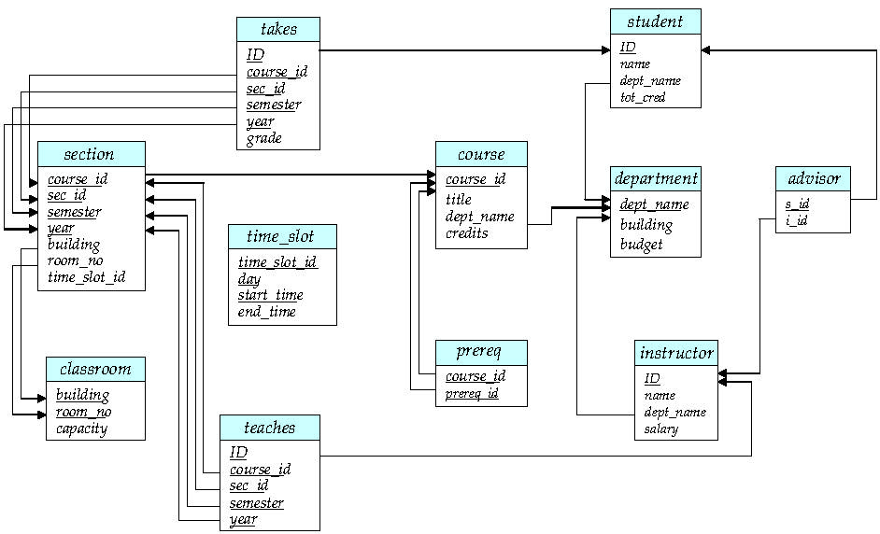
Fig. 8.0.2 Schema Diagram

Slide 4
7.1 Features of Good Relational Design
As shown in Fig. 7.0.1, logical DBS design consists of
initial relational schema generating (§6.6)
relational schema normalizing
A bad DB design, i.e. schema not being normalized well, may result in Pitfalls
repetition of information
inability to represent certain information

Slide 5
Application area/problem
in real world
requirements analysis
DBMS
independent
Specification of functional requirements
conceptual DBS design
Conceptual DBS schema , i.e. E-R schema
Initial relational schema generating
DBMS
dependent
logical DBS design
Relational schema normalizing (chapter 8)
logical DBS schema , i.e. relational data schema
physical DBS design
physical DBS schema about physical storage structure
and access method
Fig.7.0.1 DBS design

Slide 6
Example. Combine Schemas and Pitfalls
Suppose we combine two tables
instructor(ID, name, salary, dept_name) and
department(dept_name, building, budget)
into
ins_dept(ID, name, salary, dept_name, building, budget)
(No connection to relationship set inst_dept)
Result is possible repetition of information on department
many-to-one mapping cardinality from instructor to department
Pitfalls due to information repetition, when
inserting
deleting
updating

Slide 7
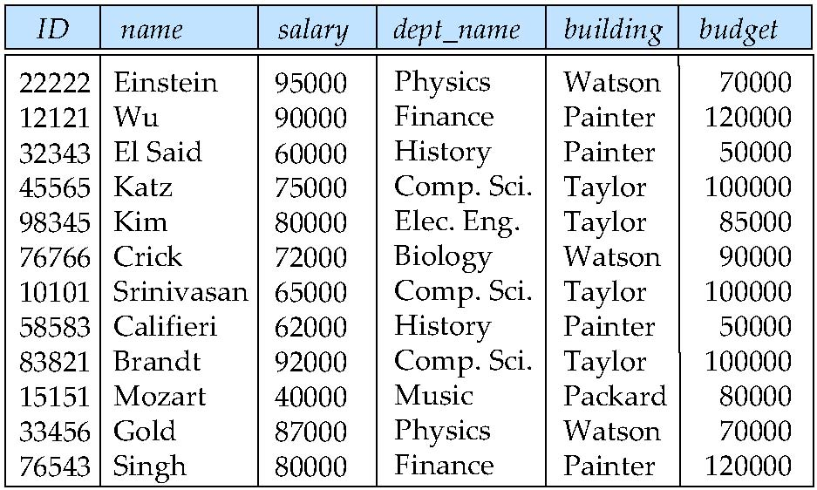
t₁
201081, Zhang, 60000, Comp.Sci Taylor 100000
t₂
null, null, null, Soft.Eng., Taylor, 100000
Fig. 7.2

Slide 8
Pitfalls
Inserting problem and information redundancy
adding a new instructor
tuple t₁ = (201081, Zhang, 60000, Comp.Sci, Taylor, 10000) is inserted into inst_dept
data for the attributes dept_name, building and budget are repeated for the instructors in the 4rd, the 7th, the 9th, and the last row that the department “Comp.Sci” makes, space is wasted
Deleting problem
e.g. if the department Comp.Sci is canceled, all instructor in it should then be removed
in Fig 8.2, every tuples containing the Comp.Sci department should be deleted
the 4rd, the 7th, and the 9th row

Slide 9
Pitfalls
Updating problem and information redundancy
information redundancy complicates updating, introducing possibility of inconsistency of the budget values
e.g. change budget of the Comp.Sci department from 100000 to 120000,
in Fig. 7.2, every tuples belonging to Comp.Sci has to be updated

Slide 10
Pitfalls
Information Representation Problem
to represent directly information about a new-opened department in which there no exists instructor, a tuple containing null values, such as
t₂ = (null, null, null, Soft.Eng., Taylor, 100000)
, is inserted
null values in DB complicate data handling in DBS
An improved design:
decompose inst_dept-schema into inst and department

Slide 11
Example: A Combined Schema Without Repetition
Consider combining relations
sec_class(sec_id, building, room_number) and
section(course_id, sec_id, semester, year)
into one relation
section(course_id, sec_id, semester, year, building, room_number)
No repetition in this case, why?
one to one mapping from section to sec_class cardinality

Slide 12
Decomposed Smaller Schemas
Suppose we had started with inst_dept. How would we know to split up (decompose) it into instructor and department?
Write a rule “if there were a schema (dept_name, building, budget), then dept_name would be a candidate key”
Denote as a functional dependency:
dept_name → building, budget
In inst_dept, because dept_name is not a candidate key, the building and budget of a department may have to be repeated.
This indicates the need to decompose inst_dept

Slide 13
Decomposed Smaller Schemas
Not all decompositions are good
Suppose we decompose employee(ID, name, street, city, salary) into
employee1 (ID, name)
employee2 (name, street, city, salary)
The next slide shows how we lose information -- we cannot reconstruct the original employee relation -- and so, this is a lossy decomposition.

Slide 14
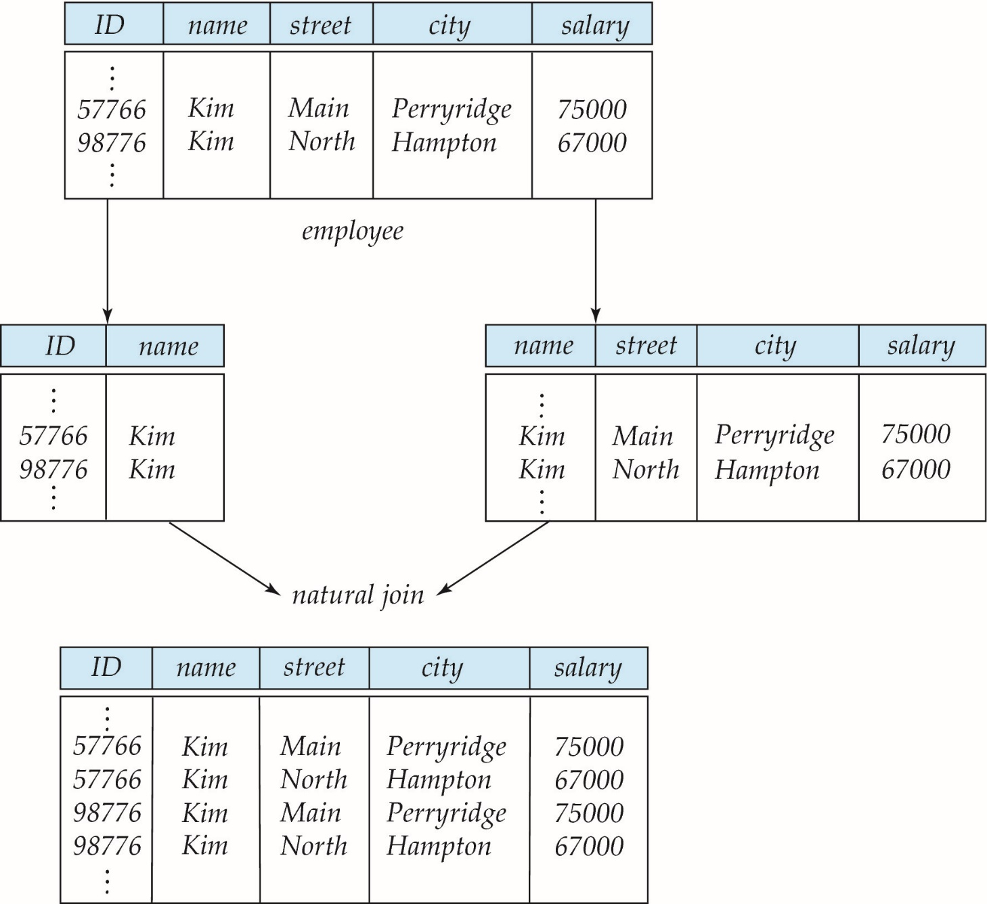
Example: A Lossy Decomposition
Fig.8.3

Slide 15
Example: Lossless-Join Decomposition
Lossless join decomposition
Decomposition of R = (A, B, C) R₁ = (A, B) R₂ = (B, C)
A
B
C
A
B
B
C
α
β
1
2
A
B
α
β
1
2
1
2
A
B
r
∏_{A,B}(r)
∏_{B,C}(r)
∏_{A} (r) ∏_{B} (r)
A
B
C
α
β
1
2
A
B

Slide 16
Lossless Decomposition
Let R be a relation schema and let R₁ and R₂ form a decomposition of R . That is R = R₁ U R₂
We say that the decomposition is a lossless decomposition if there is no loss of information by replacing R with the two relation schemas R₁ U R₂
Formally,
∏ _{R1} (r) ∏ _{R2} (r) = r
And, conversely a decomposition is lossy if
r ⊂ ∏ _{R1} (r) ∏ _{R2} (r) = r

Slide 17
Normalization Principles
在逻辑DBS设计过程中，将E-R图转换，得到面向特定应用领域的初始关系模式集
这些初始关系模式集中可能存在多种（作为完整性约束的）关系模式属性间的数据依赖 (Data Dependencies) 关系
函数依赖 (functional dependencies, FD, §8.3)
多值依赖 (Mutivalued Dependencies, MVD, §8.6
连接依赖 (Join Dependencies, JD)
如果直接根据初始关系模式构造DBS，由于初始关系模式中数据依赖关系的存在，可能会违反DB的完整性约束，导致DBS使用过程中出现如下问题，影响DBS的正确性、性能、效率
数据冗余问题、插入问题、更新问题、删除问题(pitfalls,§8.1)
略

Slide 18
Normalization Principles
因此，对初始关系模式集，需要根据关系规范化理论，在保证关系模式的
函数无损连接性（lossless join)，和/或
函数依赖保持性 (dependency preservation)
约束前提下，对关系模式集进行规范化处理——等价变换/模式分解
关系模式规范化主要步骤为
根据函数依赖的Armstrong’s 公理系统 ( §8.4.1 )和多值依赖 的公理系统 ，从初始关系模式集中已知的函数依赖和多值依赖出发，推导出初始关系模式集中所有的函数依赖（§8.4）和多值依赖
对具有函数依赖和多值依赖的初始关系模式集，采用
模式分解算法 ，
, 对其进行（等价）分解和变换，将其转换为各种范式形式，包括：
1NF(§8.2) 、 2NF (Exercise 8.16) 、 BCNF(§8.3.2 ) 、 3NF (§8.3.4) 、 4NF(§8.6.2)
, 以消除模式集中的函数依赖和多值依赖带来的负面影响, 保证数据库完整性

Slide 19
Normalization Principles
关系模式规范化处理的基本要求为:
静态关系具有第一范式形式
（理论上）动态关系最好具有3NF或BCNF形式
3种数据依赖间的关系
函数依赖是特殊的多值依赖
多值依赖又是连接依赖的特例
范式1NF、2NF、3NF、BCNF可以看作由符合范式要求的各种关系模式组成的关系模式的集合
e.g. 1NF = { R | R满足第一范式的定义}
各种范式间的关系，
参见Fig.8.0.3
1NF
2NF
3NF
BCNF
e.g.
instructor
4NF
5NF
略
略

Slide 20
略
1NF
消除非主属性对键的部分函数依赖
2NF
函数依赖保持性
消除非主属性对键的传递函数依赖
3NF
消除主属性对键的部分和传递函数依赖
BCNF
消除非平凡且非函数依赖的多值依赖
4NF
无损连接性
消除非平凡连接依赖
5NF
Fig. 8.0.3 关系范式间相互关系

Slide 21
Normalization Principles
给定一个关系模式，可以采用规范化算法将其转换为1NF、2NF、3NF、BCNF
对连接依赖和第五范式，无相应的模式规范化算法

Slide 22
Normalization Theory
Decide whether a particular relation R is in “good” form
In the case that a relation R is not in “good” form, decompose it into a set of relations {R₁， R₂, ..., R_{n}} such that
each relation is in good form
the decomposition is a lossless-join decomposition
Our theory is based on:
functional dependencies
multivalued dependencies
CSDN、知乎话题：
关系规范化理论是否有用，数据库设计是否需要？
设计要求，存在的问题
e.g. inst_dept
2) 解决手段，trade-off

Slide 23
7.2 Decomposition Using Functional Dependencies
Decide whether a particular relation R is in “good” form.
In the case that a relation R is not in “good” form, decompose it into a set of relations {R₁, R₂, ..., R_{n}} such that
each relation is in good form
the decomposition is a lossless-join decomposition
Our theory is based on:
functional dependencies
multivalued dependencies
Goal — Devise a Theory for the Following

Slide 24
Functional Dependencies
There are usually a variety of constraints (rules) on the data in the real world.
For example, some of the constraints that are expected to hold in a university database are:
Students and instructors are uniquely identified by their ID.
Each student and instructor has only one name.
Each instructor and student is (primarily) associated with only one department.
Each department has only one value for its budget, and only one associated building

Slide 25
Functional Dependencies
An instance of a relation that satisfies all such real-world constraints is called a legal instance of the relation;
A legal instance of a database is one where all the relation instances are legal instances
Functional dependency
constraints on the set of legal relations
equire that the value for a certain set of attributes determines uniquely the value for another set of attributes
A functional dependency is a generalization of the notion of a key
Function: f: X →Y,
x∈ X, y∈ Y, y = f (x)
e.g. y = 2x
for x₁, x₂∈X, if x₁= x₂, then f (x₁) = f (x₂)

Slide 26
Functional Dependencies Definition
Let R be a relation schema
α ⊆ R and β ⊆ R
The functional dependency // 函数依赖FD在关系模式R上成立/保持 //
α → β
holds on R if and only if for any legal relations r(R), whenever any two tuples t₁ and t₂ of r agree on the attributes α, they also agree on the attributes β. That is,
t₁[α] = t₂ [α] ⇒ t₁[β ] = t₂ [β ]
Example: Consider r(A,B ) with the following instance of r.
On this instance, B → A hold; A → B does NOT hold,
4
1 5
3 7

Slide 27
Relation Instance Satisfy Functional Dependency
(A particular relation instance) r(R) satisfy FD, or FD is satisfied by r(R)
/*关系 r(R) 满足函数依赖集FD, FD 被r满足*/
Given FD ={α → β} holding on R, and a relation (instance) r(R) on R,
r is said to satisfy FD, if r is legal under functional dependency set FD
note:
r is legal under FD={α → β } means
for t_{i}, t_{j} ∈r(R), if t_{i}[α]= t_{j} [α], then t_{i}[β]= t_{j} [β]
FD requires that the values for a certain set of attributes determines uniquely the value for another set of attributes

Slide 28
Example
Given relation r(R) shown below, which FD is satisfied by r
A. A →B B. AC → B C. BC →A D. B → C
t2[A]=t3[A]=3, t2[B]=5 ≠ t3[B]=4,
A →B is not satisfied
t2[AC]=t3[AC]=36, t2[B]=5 ≠ t3[B]=4,
AC →B is not satisfied
BC →A is satisfied
t1[B]=t3[B]=4, t1[C]=2 ≠ t3[C]=6,
B →C is not satisfied
A
B
C
t1
1
4
2
t2
3
5
6
t3
3
4
6
t4
7
3
8
t5
9
1
0

Slide 29
Example
Consider the schema R=(employee_ID, date, turnover per-day, department_name, manager) that describes the information about the turnover per-day (日营业额) for each employee everyday, the department that each employee works at, and the manager of the department the employee works at.
it is assumed that
at every day, each employee has only one turnover per-day
each employee works at only one department
each department is managed by only one manager
According to the descriptions mentioned above, list all the functional dependencies that hold on R
F = { employee_ID, date → turnover per-day,
employee_ID →department_name,
department_name →manager
}
Q&A: How about the E-R diagram for this example?

Slide 30
Closure of a Set of Functional Dependencies
Given a set F set of functional dependencies, there are certain other functional dependencies that are logically implied by F.
If A → B and B → C, then we can infer that A → C
etc.
The set of all functional dependencies logically implied by F is the closure of F.
We denote the closure of F by F⁺.

Slide 31
Keys and Functional Dependencies
K is a superkey for relation schema R if and only if K → R
K is a candidate key for R if and only if
K → R, and
for no α ⊂ K, α → R
Functional dependencies allow us to express constraints that cannot be expressed using superkeys. Consider the schema:
in_dep (ID, name, salary, dept_name, building, budget ).
We expect these functional dependencies to hold:
dept_name→ building
ID → building
but would not expect the following to hold:
dept_name → salary

Slide 32
FD holds on R vs FD is satisfied by r(R)
For a schema R, there may be more than one relation instance r(R), i.e. r₁(R) , r₂(R) , r₃(R) ,…, r_{m}(R) , defined on R
e.g. consider R= (A, B, C, D) , and with respect to the instances r₁(R) and r₂(R) in Fig.8.0.5
Relation r(R) satisfies α→β vs. α→β holds on schema R
if α→β holds on R, then every legal r(R) satisfies this R
but for schema R and α→β, if only some r_{i}(R) satisfies R, α→β may not hold on R.
e.g. in Fig.8.0.5, A → C and AB → D are satisfied by r₁(R) , but A → C is not satisfied by r₂(R) , so A → C does not holds on R
E.g. True or false ?
for a relation r(R) defined on schema R, if r satisfies functional dependency FD ={α → β }, then FD holds on schema R
false

Slide 33
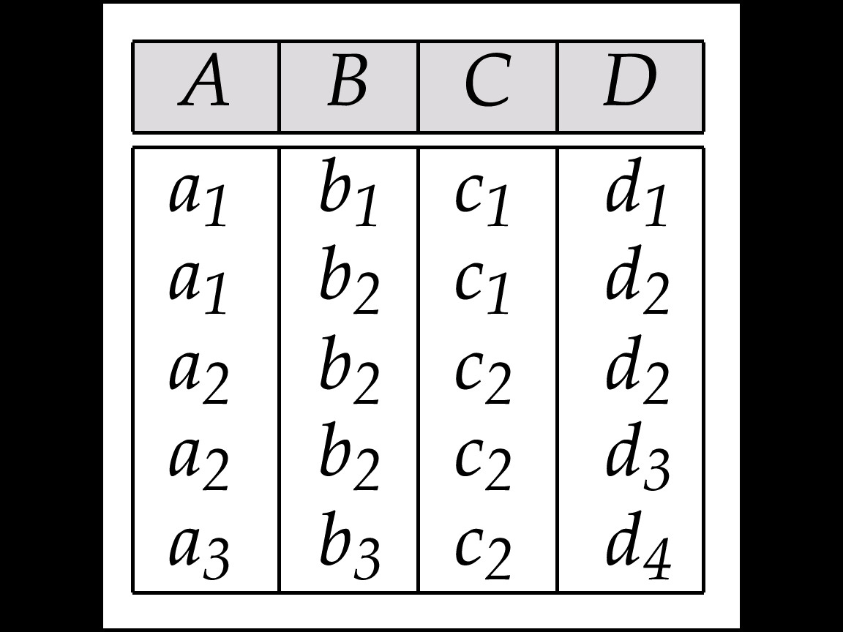
Example
FD₁= {A → C, AB → D}
, satisfied by r₁
FD₂= {AB → D}
, satisfied by r₂
r₁
r₂
t2
t2
b₃
b₃
a₁ | b₄ | c₂ | d₅
t6
A → C does not hold on R, because of t6
Fig.8.0.5 instance r₁ and r₂ defined on schema R

Slide 34
FD as Integrity in DB
While E-R diagrams describe the objects in practice and the associations among them, functional dependencies (FDs) illustrate the relationships among the features/attributes of the objects ( i.e. entities or relationships in E-R diagrams)
How to guarantee the FD in DBS?
integrity mechanisms in DBMS, i.e. keys, assertions, triggers

Slide 35
FD holds on R vs FD is satisfied by r(R)
FD holds on R
定义在R的属性间的语义约束，或R的属性间体现出的语义约束
从设计角度，R应满足的约束
FD is satisfied by r(R)
根据 R构造的实际数据r(R)是否满足语义约束FD

Slide 36
Use of Functional Dependencies
We use functional dependencies to:
test relations to see if they are legal under a given set of functional dependencies.
If a relation r is legal under a set F of functional dependencies, we say that r satisfies F.
specify constraints on the set of legal relations
We say that F holds on R if all legal relations on R satisfy the set of functional dependencies F.
Note: A specific instance of a relation schema may satisfy a functional dependency even if the functional dependency does not hold on all legal instances.
For example, a specific instance of instructor may, by chance, satisfy name → ID.

Slide 37
Trivial Functional Dependencies
A functional dependency is trivial if it is satisfied by all instances of a relation
Example:
ID, name → ID
name → name
In general, α → β is trivial if β ⊆ α

Slide 38
Transitive dependency
A functional dependency α → γ is transitive, if
α → β ，（ β ⊆ α ）， β → α ， β → γ
γ is called transitive dependent on α
传递函数依赖
E.g. Student(sno, sname, address, depart)
for transitive dependency
sno→address
, there are
sno→sname, sname→ address

Slide 39
Partial dependency
A functional dependency α → β is partial if there is a proper subset γ of α, i.e. γ ⊂α, such that
γ → β
β is called partially dependent on α
部分函数依赖
α非最小化/冗余
E.g. Student(sno, sname, address, depart)
for partial dependency
(sno, sname)→address
, there are sname→address, sno→address

Slide 40
Lossless Decomposition
We can use functional dependencies to show when certain decomposition are lossless.
For the case of R = (R₁, R₂), we require that for all possible relations r on schema R
r = ∏_{R1} (r ) ∏_{R2} (r )
A decomposition of R into R₁ and R₂ is lossless decomposition if at least one of the following dependencies is in F⁺:
R₁ ∩ R₂ → R₁
R₁ ∩ R₂ → R₂
If only R₁ ∩ R₂ → R₁ holds, then R₁ ∩ R₂ is the primary key of R₁, and the foreign key of R₂
The above functional dependencies are a sufficient condition for lossless join decomposition; the dependencies are a necessary condition only if all constraints are functional dependencies

Slide 41
Example
R = (A, B, C) F = {A → B, B → C)
R₁ = (A, B), R₂ = (B, C)
Lossless decomposition:
R₁ ∩ R₂ = {B} and B → BC
R₁ = (A, B), R₂ = (A, C)
Lossless decomposition:
R₁ ∩ R₂ = {A} and A → AB
Note:
B → BC
is a shorthand notation for
B → {B, C}

Slide 42
Dependency Preservation
Testing functional dependency constraints each time the database is updated can be costly
It is useful to design the database in a way that constraints can be tested efficiently.
If testing a functional dependency can be done by considering just one relation, then the cost of testing this constraint is low
When decomposing a relation it is possible that it is no longer possible to do the testing without having to perform a Cartesian Produced.
A decomposition that makes it computationally hard to enforce functional dependency is said to be NOT dependency preserving.

Slide 43
Dependency Preservation Example
Consider a schema:
dept_advisor(s_ID, i_ID, department_name)
With function dependencies:
i_ID → dept_name
s_ID, dept_name → i_ID
In the above design we are forced to repeat the department name once for each time an instructor participates in a dept_advisor relationship.
To fix this, we need to decompose dept_advisor
Any decomposition will not include all the attributes in
s_ID, dept_name → i_ID
Thus, the composition NOT be dependency preserving

Slide 44
7.3 Normal Forms
1NF
Boyce-Codd Normal Form
Third Normal Form

Slide 45
Atomic Domains and First Normal Form
Domain is atomic if its elements are considered to be indivisible units
Examples of non-atomic domains:
set of names, composite attributes
identification numbers like CS101 that can be broken up into parts
A relational schema R is in first normal form if the domains of all attributes of R are atomic
Non-atomic values complicate storage and encourage redundant (repeated) storage of data
Example: Set of accounts stored with each customer, and set of owners stored with each account
We assume all relations are in first normal form (and revisit this in Chapter 22: Object Based Databases)

Slide 46
Atomic Domains and First Normal Form
Atomicity is actually a property of how the elements of the domain are used.
Example: Strings would normally be considered indivisible
Suppose that students are given roll numbers which are strings of the form CS0012 or EE1127
If the first two characters are extracted to find the department, the domain of roll numbers is not atomic.
Doing so is a bad idea: leads to encoding of information in application program rather than in the database

Slide 47
Boyce-Codd Normal Form
A relation schema R is in BCNF with respect to a set F of functional dependencies if for all functional dependencies in F⁺ of the form
α → β
where α ⊆ R and β ⊆ R, at least one of the following holds:
α → β is trivial (i.e., β ⊆ α)
α is a superkey for R

Slide 48
BCNF Example
Example schema that is not in BCNF:
in_dep (ID, name, salary, dept_name, building, budget )
because :
dept_name→ building, budget
holds on in_dep
but
dept_name is not a superkey
When decompose in_dept into instructor and department
instructor is in BCNF
department is in BCNF

Slide 49
Decomposing a Schema into BCNF
Let R be a schema R that is not in BCNF. Let α →β be the FD that causes a violation of BCNF.
We decompose R into:
(α U β )
( R - ( β - α ) )
In our example of in_dep,
α = dept_name
β = building, budget
and in_dep is replaced by
(α U β ) = ( dept_name, building, budget )
( R - ( β - α ) ) = ( ID, name, dept_name, salary )

Slide 50
Example
R = (A, B, C) F = {A → B, B → C)
R₁ = (A, B), R₂ = (B, C)
Lossless-join decomposition:
R₁ ∩ R₂ = {B} and B → BC
Dependency preserving
R₁ = (A, B), R₂ = (A, C)
Lossless-join decomposition:
R₁ ∩ R₂ = {A} and A → AB
Not dependency preserving (cannot check B → C without computing R₁ R₂)

Slide 51
BCNF and Dependency Preservation
It is not always possible to achieve both BCNF and dependency preservation
Consider a schema:
dept_advisor(s_ID, i_ID, department_name)
With function dependencies:
i_ID → dept_name
s_ID, dept_name → i_ID
dept_advisor is not in BCNF
i_ID is not a superkey.
Any decomposition of dept_advisor will not include all the attributes in
s_ID, dept_name → i_ID
Thus, the composition is NOT be dependency preserving

Slide 52
BCNF and Dependency Preservation
Constraints, including functional dependencies, are costly to check in practice unless they pertain to only one relation
If it is sufficient to test only those dependencies on each individual relation of a decomposition in order to ensure that all functional dependencies hold, then that decomposition is dependency preserving
Because it is not always possible to achieve both BCNF and dependency preservation, we consider a weaker normal form, known as third normal form (3NF).

Slide 53
Third Normal Form
A relation schema R is in third normal form (3NF) if for all:
α → β in F⁺
at least one of the following holds:
α → β is trivial (i.e., β ∈ α)
α is a superkey for R
Each attribute A in β – α is contained in a candidate key for R.
(NOTE: each attribute may be in a different candidate key)
If a relation is in BCNF it is in 3NF (since in BCNF one of the first two conditions above must hold).
Third condition is a minimal relaxation of BCNF to ensure dependency preservation (will see why later).
E.g. B →ABC, (ABC) – (B) =AC
A appears in a candidate key, and C in another candidate

Slide 54
If R is in 3NF,
3NF 性质
R is also in 2NF
不存在非主属性对候选键的部分和传递依赖，i.e.每一个非主属性都不传递依赖于R的任何候选键
——只是必要条件，不是成分条件
消除非主属性对键的传递函数依赖
2NF
3NF

Slide 55
3NF Example
Consider a schema:
dept_advisor(s_ID, i_ID, dept_name)
With function dependencies:
i_ID → dept_name
s_ID, dept_name → i_ID
Two candidate keys = {s_ID, dept_name}, {s_ID, i_ID }
We have seen before that dept_advisor is not in BCNF
R, however, is in 3NF
s_ID, dept_name is a superkey
i_ID → dept_name and i_ID is NOT a superkey, but:
{ dept_name} – {i_ID } = {dept_name } and
dept_name is contained in a candidate key

Slide 56
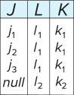
Redundancy in 3NF
Consider the schema R below, which is in 3NF
What is wrong with the table?
Repetition of information
Need to use null values (e.g., to represent the relationship l₂, k₂
where there is no corresponding value for J)
R = (J, K, L )
F = {JK → L, L → K }
And an instance table:

Slide 57
Comparison of BCNF and 3NF
Advantages to 3NF over BCNF. It is always possible to obtain a 3NF design without sacrificing losslessness or dependency preservation.
Disadvantages to 3NF.
We may have to use null values to represent some of the possible meaningful relationships among data items.
There is the problem of repetition of information.

Slide 58
Goals of Normalization
Let R be a relation scheme with a set F of functional dependencies.
Decide whether a relation scheme R is in “good” form.
In the case that a relation scheme R is not in “good” form, need to decompose it into a set of relation scheme {R₁, R₂, ..., R_{n}} such that:
Each relation scheme is in good form
The decomposition is a lossless decomposition
Preferably, the decomposition should be dependency preserving.

Slide 59
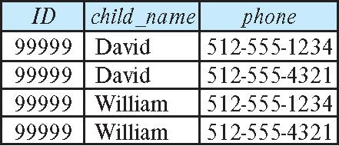
How good is BCNF?
There are database schemas in BCNF that do not seem to be sufficiently normalized
Consider a relation
inst_info (ID, child_name, phone)
where an instructor may have more than one phone and can have multiple children
Instance of inst_info
There are no non-trivial functional dependencies and therefore the relation is in BCNF
Insertion anomalies – i.e., if we add a phone 981-992-3443 to 99999, we need to add two tuples
(99999, David, 981-992-3443) (99999, William, 981-992-3443
多值依赖

Slide 60
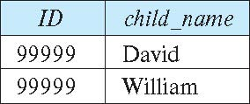
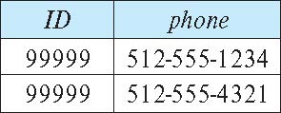
Higher Normal Forms
It is better to decompose inst_info into:
inst_child:
inst_phone:
This suggests the need for higher normal forms, such as Fourth Normal Form (4NF), which we shall see later

Slide 61
7.4 Functional-Dependency Theory
We now consider the formal theory that tells us which functional dependencies are implied logically by a given set of functional dependencies
Closure of Functional Dependencies
Closure of Attribute Sets
Canonical Cover
Extraneous Attributes
Dependency Preservation

Slide 62
Goal
1. We now consider the formal theory that tells us which functional dependencies are implied logically by a given set of functional dependencies.
2. We then develop algorithms to generate lossless decompositions into BCNF and 3NF
3. We then develop algorithms to test if a decomposition is dependency-preserving

Slide 63
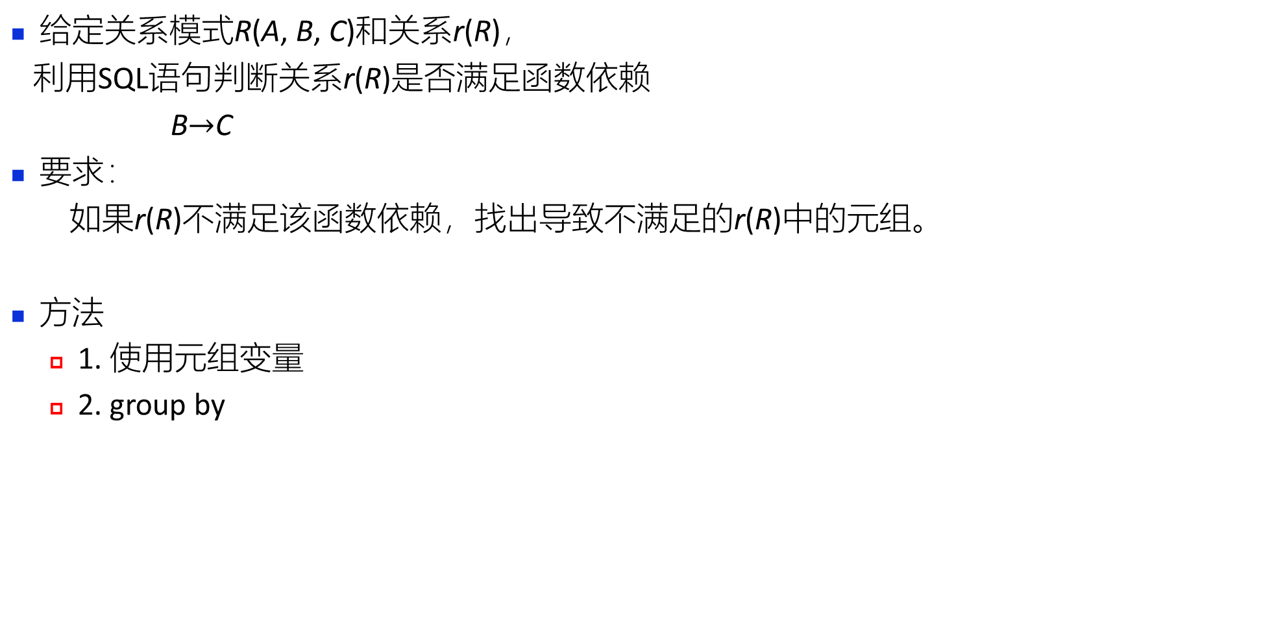
SQL Statements for FD Judgment
给定关系模式R(A, B, C)和关系r(R)，
利用SQL语句判断关系r(R)是否满足函数依赖
B$→$C
要求：
如果r(R)不满足该函数依赖，找出导致不满足的r(R)中的元组。
方法
1. 使用元组变量
2. group by
T
S
select ？
from r as T, r as S
where T.B=S.B
and T.C<>S.C
A | B | C | A | B | C
1 | 2 | 3 | 1 | 2 | 3
1 | 2 | 3 | 1 | 2 | 4
1 | 2 | 4 | 1 | 2 | 3
1 | 2 | 4 | 1 | 2 | 4

Slide 64
Closure of a Set of Functional Dependencies
Given a set F set of functional dependencies, there are certain other functional dependencies that are logically implied by F.
If A → B and B → C, then we can infer that A → C
etc.
The set of all functional dependencies logically implied by F is the closure of F.
We denote the closure of F by F⁺.
F⁺ = { f | f is logically implied by F }
E.g. in Fig. 8.0.5, {A → B , B → C }⁺
= {A → B , B → C, A → C, … }

Slide 65
F ={A → B , B → C };
f: A → C is logically implied by F
A
B
C
t1
1
4
2
t2
3
5
6
t3
4
4
2
t4
7
3
8
t5
9
1
0
Fig. 8.0.5

Slide 66
Closure of a Set of Functional Dependencies
We can compute F⁺, the closure of F, by repeatedly applying Armstrong’s Axioms:
Reflexive rule: if β ⊆ α, then α → β
Augmentation rule: if α → β, then γ α → γ β
Transitivity rule: if α → β, and β → γ, then α → γ
These rules are
Sound -- generate only functional dependencies that actually hold, and
Complete -- generate all functional dependencies that hold

Slide 67
Closure of Functional Dependencies (Cont.)
Additional rules:
Union rule: If α → β holds and α → γ holds, then α → β γ holds.
Decomposition rule: If α → β γ holds, then α → β holds and α → γ holds.
Pseudotransitivity rule:If α → β holds and γ β → δ holds, then α γ → δ holds.
The above six rules can be inferred from Armstrong’s axioms.

Slide 68
Example of F⁺
R = (A, B, C, G, H, I) F = { A → B A → C CG → H CG → I B → H}
Some members of F⁺
A → H
by transitivity from A → B and B → H
AG → I
by augmenting A → C with G, to get AG → CG and then transitivity with CG → I
CG → HI
by augmenting CG → I to infer CG → CGI,
and augmenting of CG → H to infer CGI → HI,
and then transitivity

Slide 69
Example
Question
Which rule about functional dependencies shown below is right
A. if α→β then β→α
B if A→C , BC→D then AB→D
C. if AB→C then B→C
D if α⊆β, then α→β
Answer: B

Slide 70
Procedure for Computing F⁺
略
To compute the closure of a set of functional dependencies F:
F ⁺ = F repeat for each functional dependency f in F⁺ apply reflexivity and augmentation rules on f add the resulting functional dependencies to F ⁺ for each pair of functional dependencies f₁and f₂ in F ⁺ if f₁ and f₂ can be combined using transitivity then add the resulting functional dependency to F ⁺ until F ⁺ does not change any further
NOTE: We shall see an alternative procedure for this task later

Slide 71
Closure of Attribute Sets
An attribute B is functionally determined by α if α →B
Given a set of attributes a, define the closure of a under F (denoted by a⁺) as the set of attributes that are functionally determined by a under F
α ⁺ ={β | β is functionally determined by α under F}

Slide 72
Closure of Attribute Sets
Algorithm to compute α⁺, the closure of α under F
Input: α , F
Output: α ⁺
result := a; while (changes to result) do for each β → γ in F do begin if β ⊆ result then result := result ∪ γ end

Slide 73
Example of Attribute Set Closure
R = (A, B, C, G, H, I)
F = {A → B A → C CG → H CG → I B → H}
(AG)⁺
1. result = AG
2. result = ABCG (A → C and A → B)
3. result = ABCGH (CG → H and CG ⊆ AGBC)
4. result = ABCGHI
(CG → I and CG ⊆ AGBCH)
Is AG a candidate key?
1. Is AG a super key?
Does AG → R? == Is R ⊇ (AG)⁺
Is any subset of AG a superkey?
Does A → R? == Is R ⊇ (A)⁺
Does G → R? == Is R ⊇ (G)⁺
In general: check for each subset of size n-1

Slide 74
Uses of Attribute Closure
There are several uses of the attribute closure algorithm:
Testing for superkey:
To test if α is a superkey, we compute α^{+,} and check if
α⁺ contains all attributes of R
Testing functional dependencies
To check if a functional dependency α → β holds (or, in other words, is in F⁺), just check if
β ⊆ α⁺
That is, we compute α⁺ by using attribute closure, and then check if it contains β.
Is a simple and cheap test, and very useful
Computing closure of F
For each γ ⊆ R, we find the closure γ⁺, and for each S ⊆ γ⁺, we output a functional dependency γ → S
略

Slide 75
Def. For functional dependencies F and G, if
F⁺= G⁺
then F and G are equivalent
E.g. F={A → B , B → C } is equivalent to
G={A → B , B → C, A → C }

Slide 76
Canonical Cover
Suppose that we have a set of functional dependencies F on a relation schema. Whenever a user performs an update on the relation, the database system must ensure that the update does not violate any functional dependencies; that is, all the functional dependencies in F are satisfied in the new database state.
If an update violates any functional dependencies in the set F, the system must roll back the update.
checking all α → β in F holding on R is time-consuming
F may have redundant dependencies that can be inferred from the others
We can reduce the effort spent in checking for violations by testing a simplified set of functional dependencies that has the same closure as the given set.
This simplified set is termed the canonical cover
To define canonical cover we must first define extraneous attributes.
An attribute of a functional dependency in F is extraneous if we can remove it without changing F ⁺

Slide 77
Extraneous Attributes
Removing an attribute from the left side of a functional dependency could make it a stronger constraint.
For example, if we have AB → C and remove B, we get the possibly stronger result A → C. It may be stronger because A → C logically implies AB → C, but AB → C does not, on its own, logically imply A → C
But, depending on what our set F of functional dependencies happens to be, we may be able to remove B from AB → C safely.
For example, suppose that
F = {AB → C, A → D, D → C}
Then we can show that F logically implies A → C, making extraneous in AB → C.

Slide 78
Sets of functional dependencies may have redundant dependencies that can be inferred from the others
E.g. A → C is redundant in: {A → B, B → C, A→ C}
Parts of a functional dependency may be redundant
E.g. on RHS: {A → B, B → C, A → CD} can be simplified to {A → B, B → C, A → D}
E.g. on LHS: {A → B, B → C, AC → D} can be simplified to {A → B, B → C, A → D}

Slide 79
Extraneous Attributes (Cont.)
Removing an attribute from the right side of a functional dependency could make it a weaker constraint.
For example, if we have AB → CD and remove C, we get the possibly weaker result AB → D. It may be weaker because using just AB → D, we can no longer infer AB → C.
But, depending on what our set F of functional dependencies happens to be, we may be able to remove C from AB → CD safely.
For example, suppose that
F = { AB → CD, A → C.
Then we can show that even after replacing AB → CD by AB → D, we can still infer $AB → C and thus AB → CD.

Slide 80
Extraneous Attributes
An attribute of a functional dependency in F is extraneous if we can remove it without changing F ⁺
Consider a set F of functional dependencies and the functional dependency α → β in F.
Remove from the left side: Attribute A is extraneous in α if
A ∈ α and
F logically implies (F – {α → β}) ∪ {(α – A) → β}.
Remove from the right side: Attribute A is extraneous in β if
A ∈ β and
The set of functional dependencies
(F – {α → β}) ∪ {α →(β – A)} logically implies F.
Note: implication in the opposite direction is trivial in each of the cases above, since a “stronger” functional dependency always implies a weaker one

Slide 81
Def. Consider a set F of functional dependency and α → β in F,
attribute A is extraneous in α, if
A ∈ α, and
F implies (F – {α → β}) ∪ {(α – A) → β}=F’
that is, F⁺ ⊇ (F – {α → β}) ∪ {(α – A) → β}
attribute A is extraneous in β, if
A ∈ β , and
the set of functional dependencies
F’= (F – {α → β}) ∪ {α →(β – A)} implies F
that is, ((F – {α → β}) ∪ {α)→ (β – A)})⁺ ⊇ F
替换
替换

Slide 82
Testing if an Attribute is Extraneous
Let R be a relation schema and let F be a set of functional dependencies that hold on R . Consider an attribute in the functional dependency α → β.
To test if attribute A ∈ β is extraneous in β
α→A under F’ ?
Consider the set: F' = (F – {α → β}) ∪ {α →(β – A)},
check that α⁺ contains A, A ∈ α⁺ ?
f it does, A is extraneous in β

Slide 83
Testing if an Attribute is Extraneous
To test if attribute A ∈ α is extraneous in α
(α –A) →β under F ?
Let γ = α – {A}. Check if γ → β can be inferred from F.
Compute γ⁺ using the dependencies in F
If γ⁺ = (α-A)⁺ includes all attributes in β , i.e. β∈ (α – A)⁺ , then , A is extraneous in α

Slide 84
Examples of Extraneous Attributes
Example: Given F = {A → C, AB → C }
B is extraneous in AB → C because {A → C, AB → C} logically implies A → C (i.e. the result of dropping B from AB → C).
Example: Given F = {A → C, AB → CD}
C is extraneous in AB → CD since AB → C can be inferred even after deleting C
Let F = {AB → CD, A → E, E → C }
To check if C is extraneous in AB → CD, we:
Compute the attribute closure of AB under F' = {AB → D, A → E, E → C}
The closure is ABCDE, which includes CD
This implies that C is extraneous

Slide 85
Canonical Cover
It is desirable to test a “minimal” set of functional dependencies equivalent to F
Intuitively, a canonical cover (正则覆盖) of F, denoted as F_{c}, is
a “minimal” set of functional dependencies equivalent to F
without redundant functional dependencies or attributes
F⁺ = F_{c}⁺
A canonical cover for F is a set of dependencies F_{c} such that
F logically implies all dependencies in F_{c} , and
F_{c} logically implies all dependencies in F, and
No functional dependency in F_{c} contains an extraneous attribute, and
Each left side of functional dependency in F_{c} is unique. That is, there are no two dependencies in F_{c}
α₁ → β₁ and α₂ → β₂ such that
α₁ = α₂

Slide 86
F, F⁺, and F_{C}
F⁺ = F_{c}⁺
F_{C}
shrink
grow
F⁺
F

Slide 87
Canonical Cover
To compute a canonical cover for F:
repeat
Use the union rule to replace any dependencies in F of the form
α₁ → β₁ and α₁ → β₂ with α₁ → β₁ β₂
Find a functional dependency α → β in F_{c} with an extraneous
attribute either in α or in β
/* Note: test for extraneous attributes done using F_{c,} not F*/
If an extraneous attribute is found, delete it from α → β
until (F_{c} not change
Note: Union rule may become applicable after some extraneous attributes have been deleted, so it has to be re-applied

Slide 88
Note: Union rule may become applicable after some extraneous attributes have been deleted, so it has to be re-applied
Note:
for a set F of functional dependencies, there may be several F_{c,}

Slide 89
Example: Computing a Canonical Cover
R = (A, B, C) F = {A → BC B → C A → B AB → C}
Combine A → BC and A → B into A → BC
Set is now {A → BC, B → C, AB → C}
A is extraneous in AB → C
Check if the result of deleting A from AB → C is implied by the other dependencies
Yes: in fact, B → C is already present!
Set is now {A → BC, B → C}
C is extraneous in A → BC
Check if A → C is logically implied by A → B and the other dependencies
Yes: using transitivity on A → B and B → C.
Can use attribute closure of A in more complex cases
The canonical cover is: A → B B → C

Slide 90
Dependency Preservation
Let F_{i} be the set of dependencies F ⁺ that include only attributes in R_{i}.
A decomposition is dependency preserving, if
(F₁ ∪ F₂ ∪ … ∪ F_{n} )⁺ = F ⁺
Using the above definition, testing for dependency preservation take exponential time.
Not that if a decomposition is NOT dependency preserving then checking updates for violation of functional dependencies may require computing joins, which is expensive.

Slide 91
Dependency Preservation (Cont.)
Let F be the set of dependencies on schema R and let R₁, R₂ , .., R_{n} be a decomposition of R.
The restriction of F to R_{i} is the set F_{i} of all functional dependencies in F ⁺ that include only attributes of R_{i} .
Since all functional dependencies in a restriction involve attributes of only one relation schema, it is possible to test such a dependency for satisfaction by checking only one relation.
Note that the definition of restriction uses all dependencies in in F ⁺, not just those in F.
The set of restrictions F₁, F₂ , .. , F_{n} is the set of functional dependencies that can be checked efficiently.

Slide 92
Testing for Dependency Preservation
To check if a dependency α → β is preserved in a decomposition of R into R₁, R₂, …, R_{n} , we apply the following test (with attribute closure done with respect to F)
result = α repeat for each R_{i} in the decomposition t = (result ∩ R_{i})⁺ ∩ R_{i} result = result ∪ t
until (result does not change)
If result contains all attributes in β, then the functional dependency α → β is preserved.
We apply the test on all dependencies in F to check if a decomposition is dependency preserving
This procedure takes polynomial time, instead of the exponential time required to compute F⁺ and (F₁ ∪ F₂ ∪ … ∪ F_{n})⁺

Slide 93
Example
R = (A, B, C ) F = {A → B B → C} Key = {A}
R is not in BCNF
Decomposition R₁ = (A, B), R₂ = (B, C)
R₁ and R₂ in BCNF
Lossless-join decomposition
Dependency preserving

Slide 94
7.5 Algorithm for Decomposition Using Functional Dependencies
1
We then develop algorithms to generate lossless decompositions into BCNF and 3NF
We then develop algorithms to test if a decomposition is dependency-preserving

Slide 98

Thanks for your attention

